Slide 1

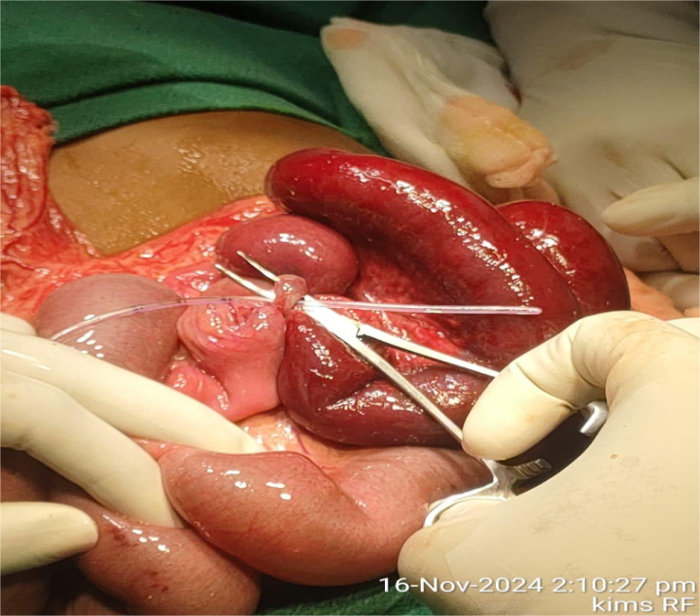
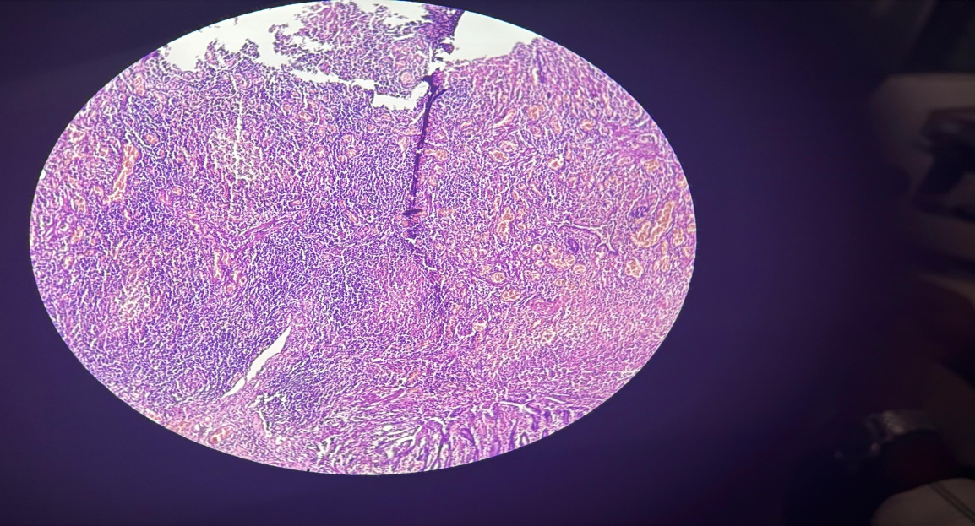
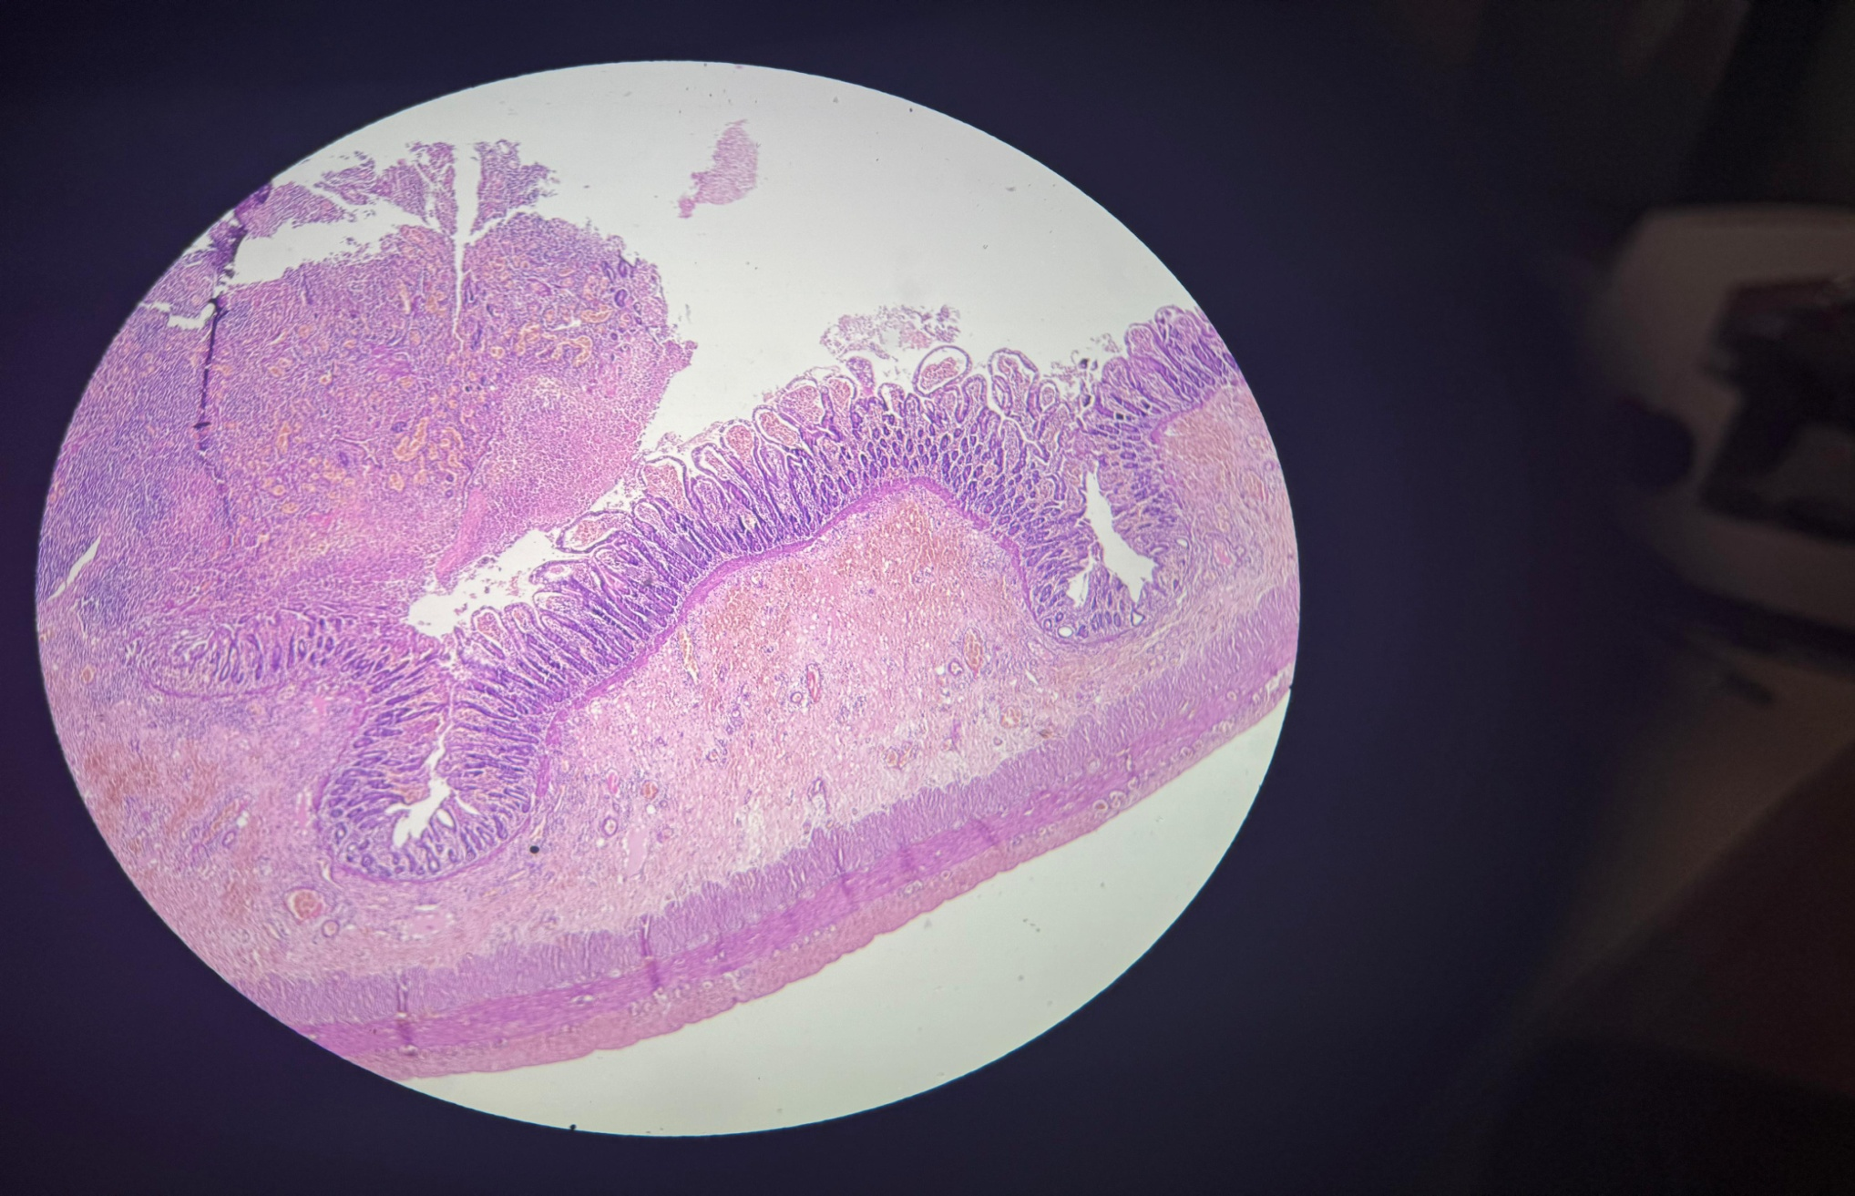
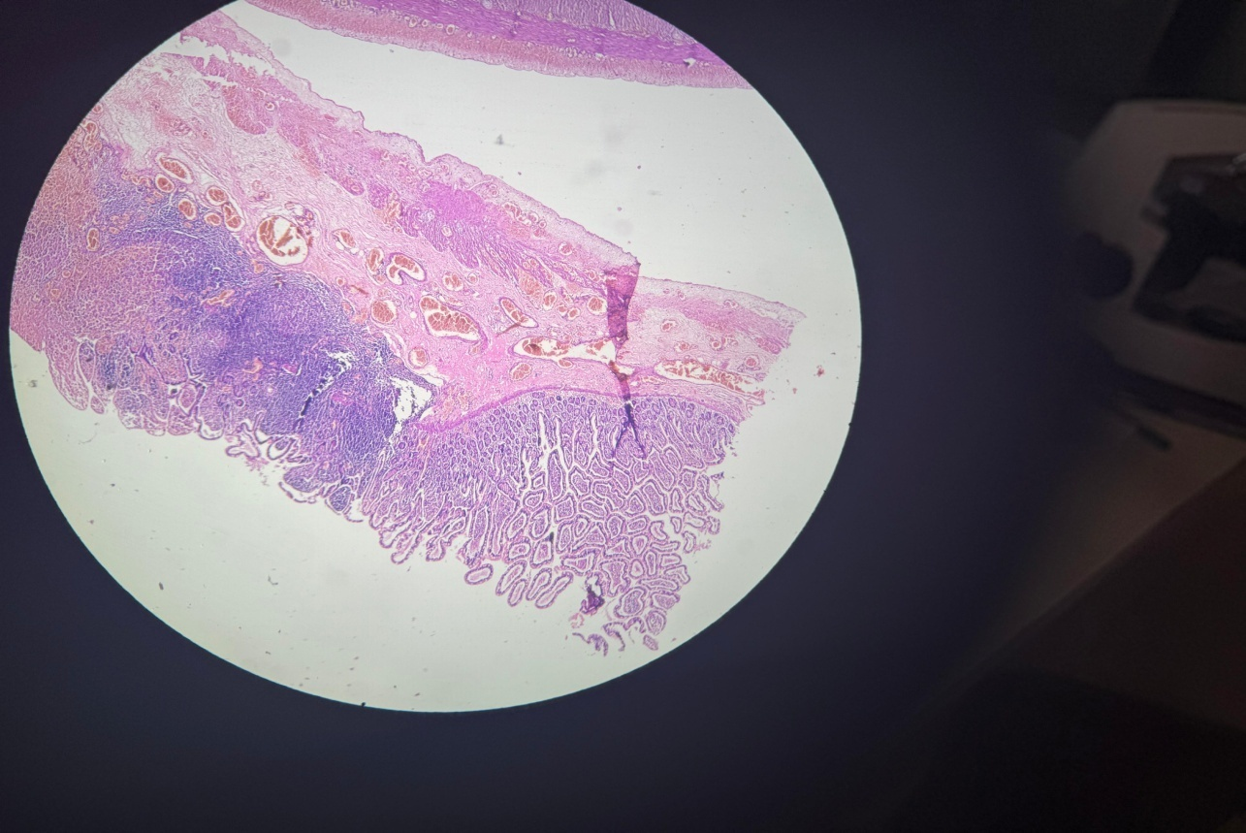
A RARE CASE OF MECKEL’S DIVERTICULUM CAUSING SMALL INTESTINAL OBSTRUCTION IN A 4 YEAR OLD BOY
Presenting Author: Dr. S. Ahamed Faheemudeen | Under the Guidance of: Prof & HOD Dr. P. S. Saravanan
Institution: Meenakshi Medical Collge Hospital and Research center, Kanchipuram.
Abstract ID: AS549
INTRODUCTION
INTRAOPERATIVE FINDINGS
MECKEL’S DIVERTICULUM(MD) :
• Most common congenital anomaly of the GI tract.
• Results from failure of normal regression of Vitelline duct (5-7wks)
Rule of 2’s:
• Occurs in roughly 2% of the population.
• Typically situated within 2 feet proximal to the ileocecal valve & 2 inches in length
• Most frequently becomes symptomatic before the age of 2 years.
• Contains 2 types of ectopic tissue: gastric mucosa (70% ) and pancreatic tissue (5%).
• Primary clinical manifestations include gastrointestinal hemorrhage, diverticulitis, and mechanical bowel obstruction.
Exploratory Laparotomy done. Meckel’s Diverticulum identified and diverticulum was attached to its base forming a band under which a loop of small intestine had become entraped resulting in mechanical obstruction of the small intestine.
The diverticulum along with the adjancent strangulated small bowel loops were resected and side to side bowel anastomosis with double layer closure done, subsequent histopathological analysis confirming ectopic gastric tissue.
CASE REPORT PRESENTATION
A 4-year-old male child was brought to the outpatient department reporting a 24-hour history of diffuse, colicky abdominal pain. This was accompanied by constipation, progressive abdominal distension, and episodes of non-bilious emesis, alongside a documented fever.
On physical examination, the pediatric patient appeared lethargic, exhibiting diffuse abdominal tenderness and hypoactive bowel sounds.
CECT Abdomen & Pelvis shows dilated small bowel loops (jejunal, proximal ileal loops) with multiple air fluid levels. F/s/o Small Bowel Obstruction due to adhesions or internal hernia.
RESULTS
Histopathological biopsy of the specimen shows:
A) Glandular or acinar structures resembling pancreatic acini-suggests ectopic pancreatic tissue.
B) Ectopic gastric mucosa with foveolar cells, parietal cells(pink),chief cells(purple)
C) Gastric type mucosa with mucosal discontinuity, haemorrhage suggests ulceration.
[Image A]
[Image B]
[Image C]
CONCLUSION
MD must remain a key consideration in the differential diagnosis for pediatric patients presenting with an acute abdomen, unexplained lower GI hemorrhage, or Small bowel obstruction.
Prompt diagnostic evaluation and timely surgical management are critical to minimizing morbidity in symptomatic cases. Incidentally found asymptomatic MD should be left alone.
DISCUSSION
REFERENCES
Intestinal obstruction is an uncommon presentation of MD. In our case patient presented with severe abdominalpain, distension raising suspicion of MD, surgical exploration confirmed diverticulum.
HPE revealed ectopic gastric mucosa, pancreatic tissue, mucosal ulceration confirming diagnosis of MD.
1. Rattan KN, Singh J, Dalal P, Rattan A. Meckel's diverticulum in children: Our 12-year experience. Afr J Paediatr Surg. 2016 Oct-Dec;13(4):170-174. doi: 10.4103/0189-6725.194671. PMID: 28051045; PMCID: PMC5154221.
49th Annual State Conference of the Tamil Nadu Chapter of Association of Surgeons of India – 06th to 09th August 2026 | Venue: PSG Hospitals, Coimbatore

